Slide 1


Final Exam Review
So it has come to this…

Slide 2
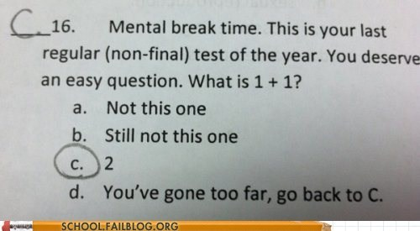
Format
32 questions
30 multiple choice
2 short answer
Topics:
MOSTLY game design and play book
Design Patterns
INCLUDING student presentations
Other topics (i.e. FK, IK, AI, Pathfinding, etc)
This is a quaint reminder of the before times. I have no way to enforce this, so go nuts.
You get 1(one) page of notes. Front and back.
Must be an orientable surface
Not to exceed 8.5in. x 11in.
I reserve the right to refuse any ridiculously sized/formatted notes. ☺
This Photo by Unknown Author is licensed under CC BY-SA-NC

Slide 3

Game Design and Play
Be familiar with the chapters we have covered.
I'd suggest reviewing the summaries and past HW

Slide 4
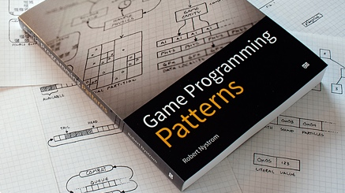
Design Patterns
Review all the patterns we mentioned in class
Not the worst idea to check out some we DIDN'T Cover as well…
Student presented patters should also be reviewed
This Photo by Unknown Author is licensed under CC BY-SA

Slide 5
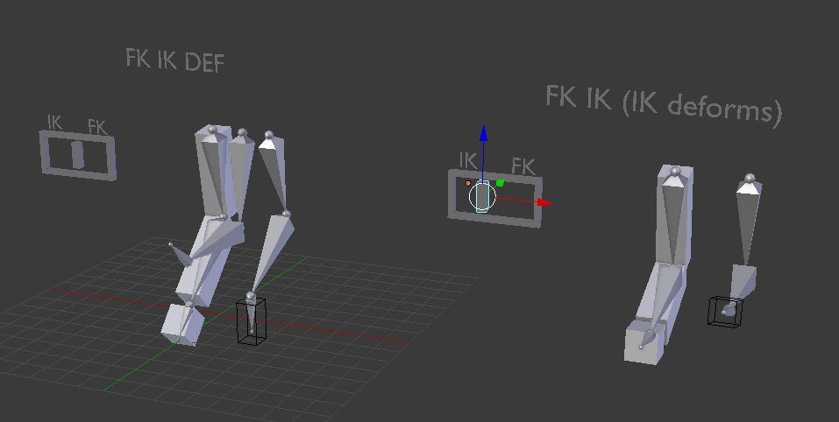
FK vs IK
Know which is Forward Kinematics and which is Inverse
Know which kind of joints these techniques work on
Probably a good idea to know what is meant by an end-effector
This Photo by Unknown Author is licensed under CC BY-SA

Slide 6


AI
What is strong AI?
What is weak AI?
What is the Chinese room experiment
What is the Turing test
Who won the Turing test?
How is AI used in games?
Think different applications and models
GOAP for example

Slide 7
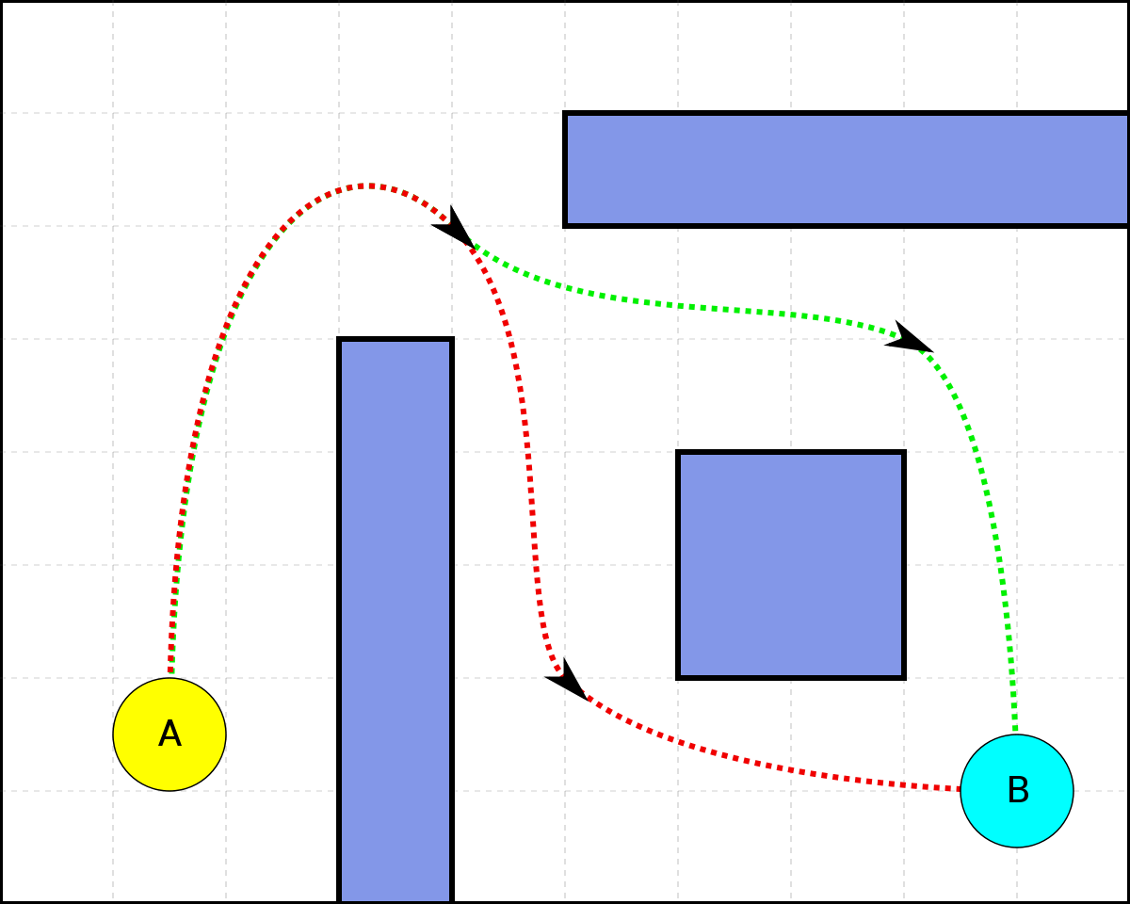
Pathfinding
What is the major difference between
A* and Dijkstra?
What is the general implementation process for either?
What is the specific thing that makes them different?

Slide 8
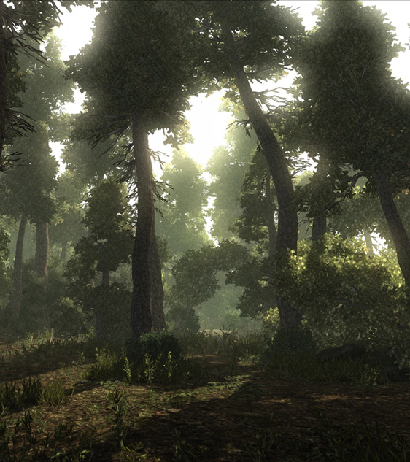
Procedural Generation
How are natural functions (Perlin noise, Sine Waves, etc.) used to make procedural content more realistic?
What are some techniques for generating a map?
How are the biomes in Minecraft created?
What are Markov chains?
What is an L-System?

